Slide 1


Event Management System
Presented By-
Mr. Nimish J. Patil (219116)
Mr.Rohit R. Warke (219229)

Slide 2
Points to be discussed
Introduction
Objectives
UML Diagrams
Screenshots
Specification
S/W and H/W Requirement
Advantages
Conclusion
References

Slide 3
Introduction
Event Management System is not only digitalizing the booking of orders providing ease of access to the customers, but will also digitalize the firm’s functionalities such as adding/removing employees, vendors etc. Providing All Events Info Features managing all employees and assign task for the events .In short, our management system will digitalize the whole firm along with its jobs.

Slide 4
Objectives
To produce a web-based system that allow the admin to add different Vendors and Employee’s and provide functionalities to its role.
To ease Clients by providing different functionalities for Event Booking.
To ease Managers to assign different tasks to Employees and track work efficiently.
In Other Words the main idea is to centralised all Event Management Operations

Slide 5
Technology Used
Front End : ReactJs
Back End : Java Spring Boot API

Slide 6
UML Diagram

Slide 7
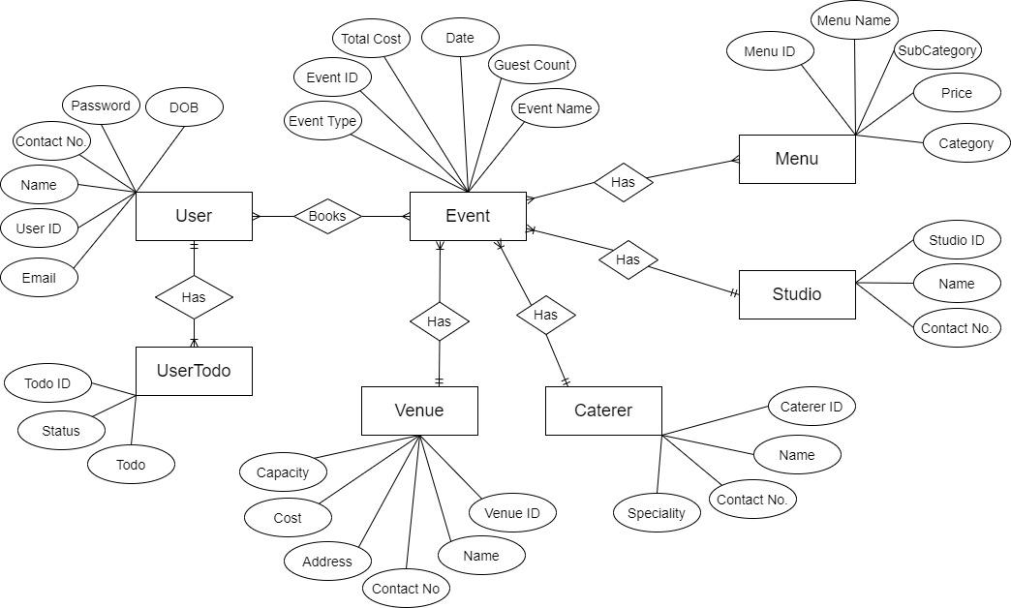
Manual E-R Diagram

Slide 8
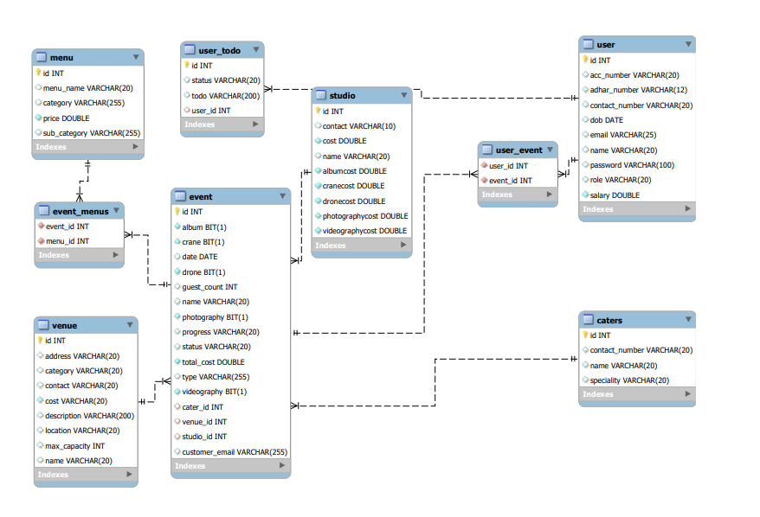
System Generated E-R Diagram

Slide 9
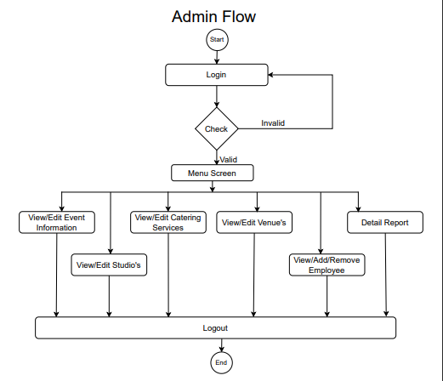
Activity Diagram Of Admin

Slide 10
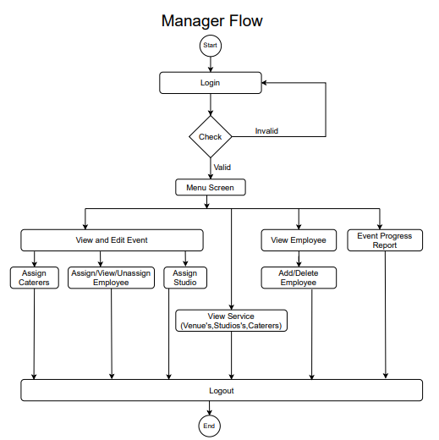
Activity Diagram Of Manager

Slide 11
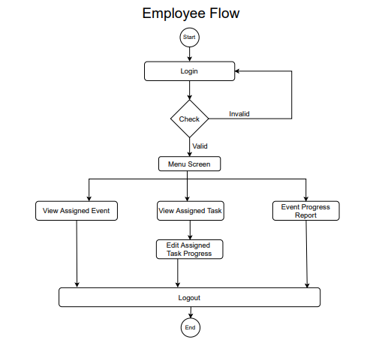
Activity Diagram Of Employee

Slide 12
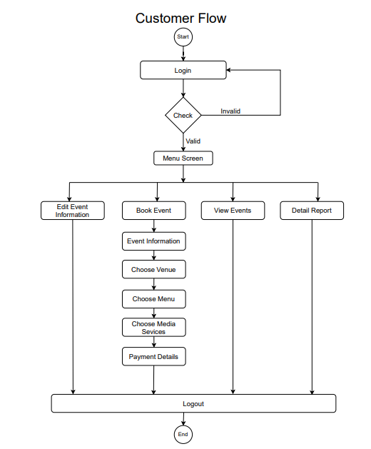
Activity Diagram Of Customer

Slide 13
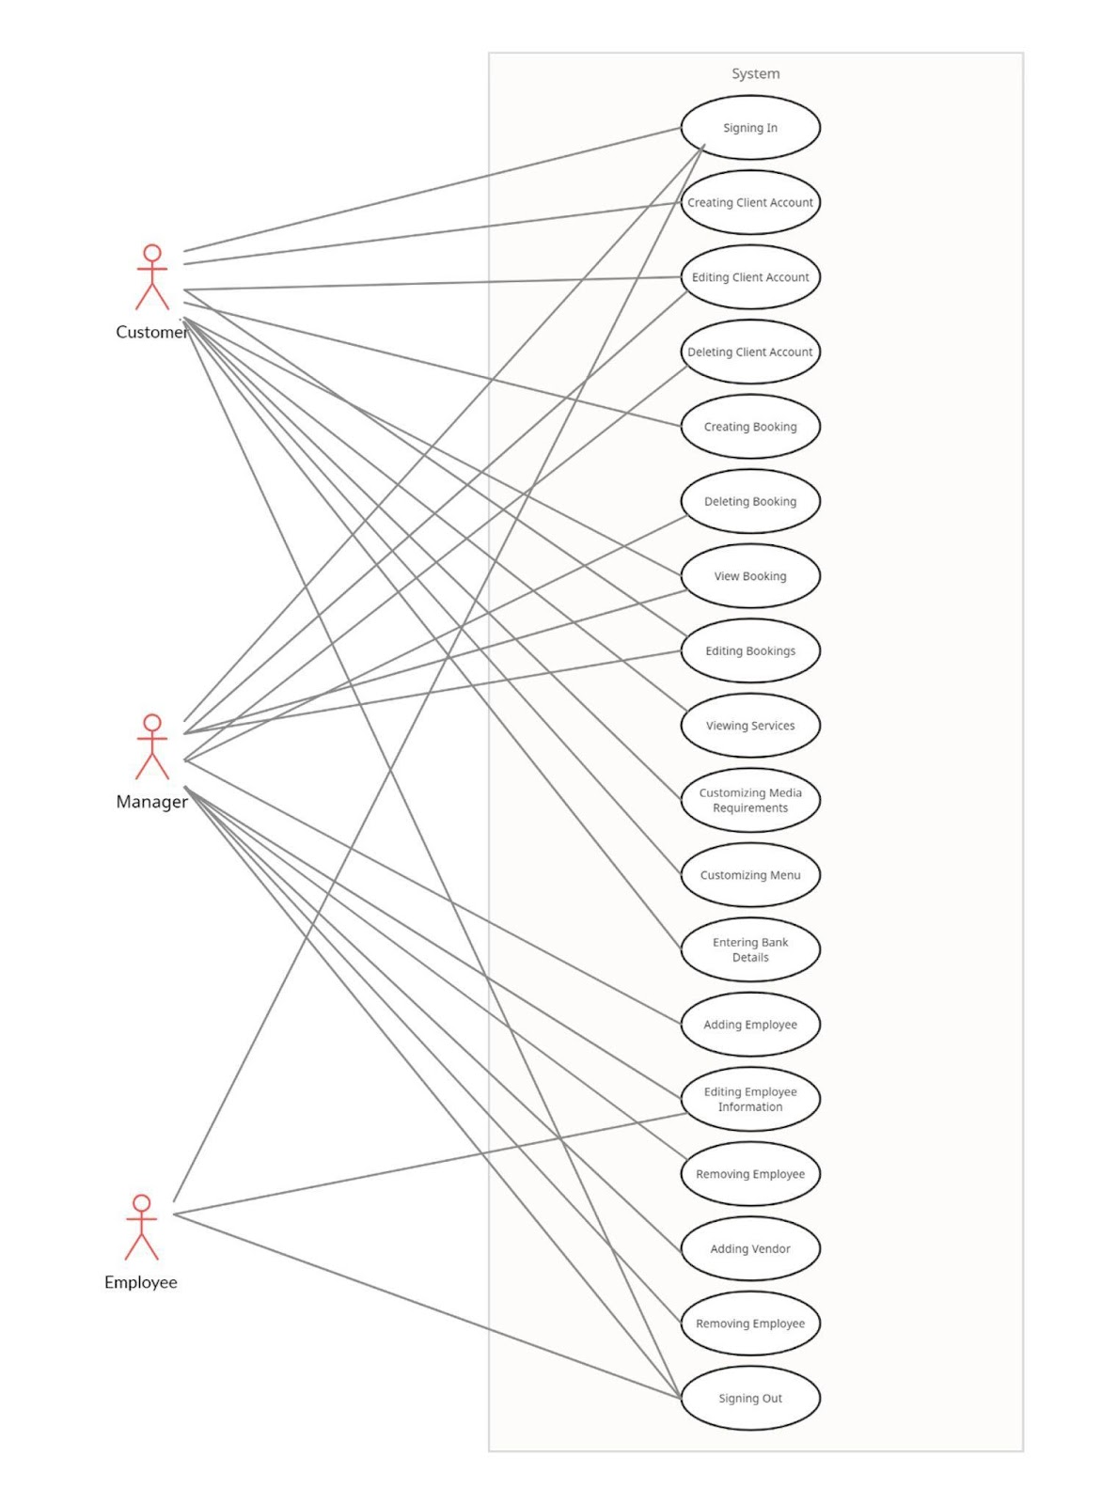
Use Case Diagram

Slide 14
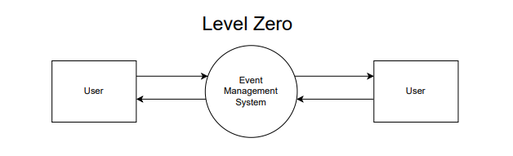
DFD Diagram

Slide 15
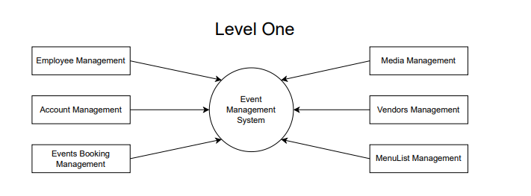
DFD Diagram

Slide 16
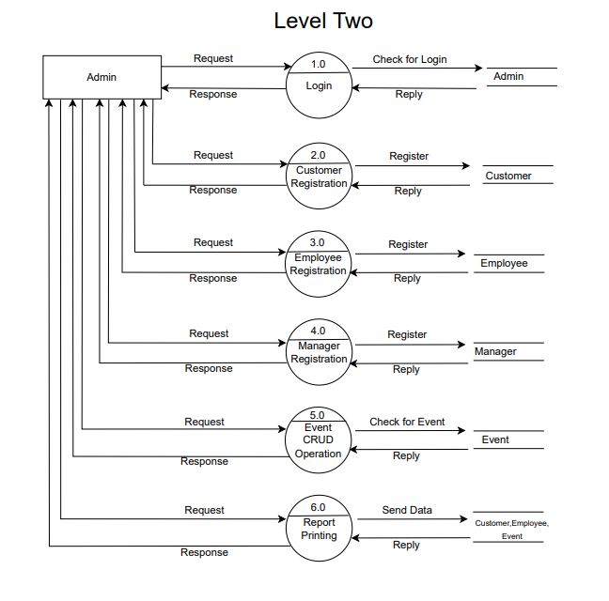
DFD Diagram

Slide 17
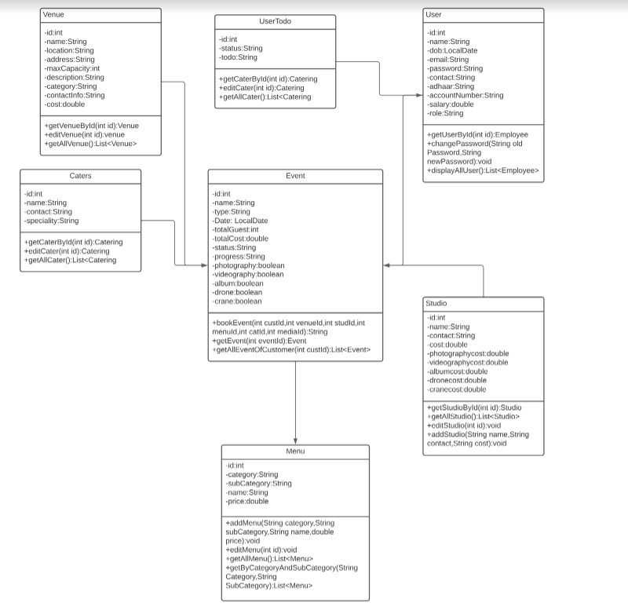
Class Diagram

Slide 18
Screen Shots

Slide 19
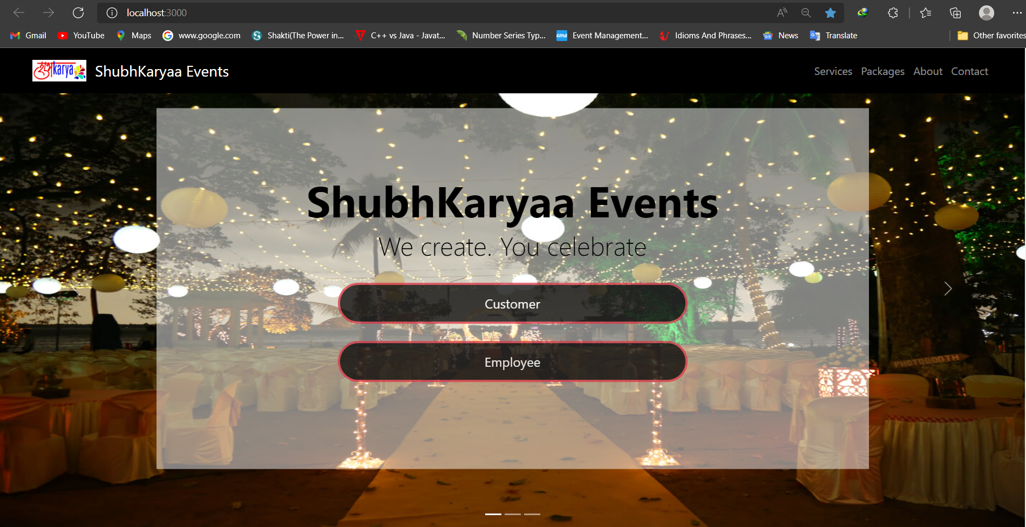

Slide 20
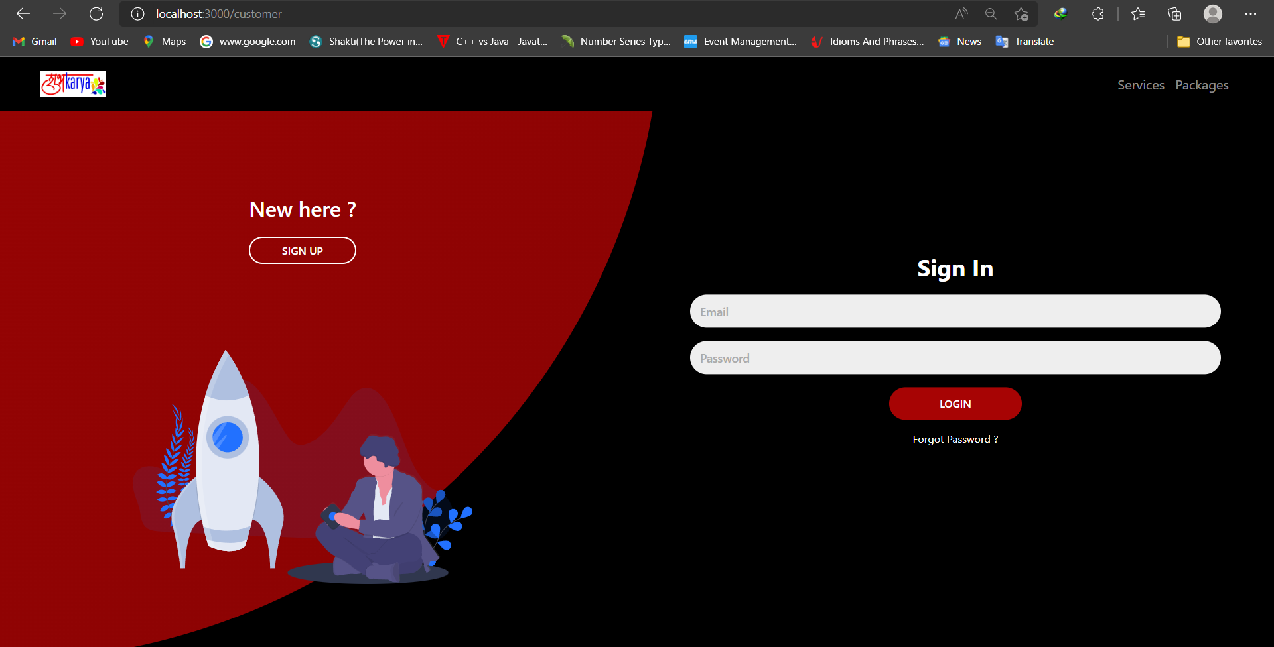

Slide 21
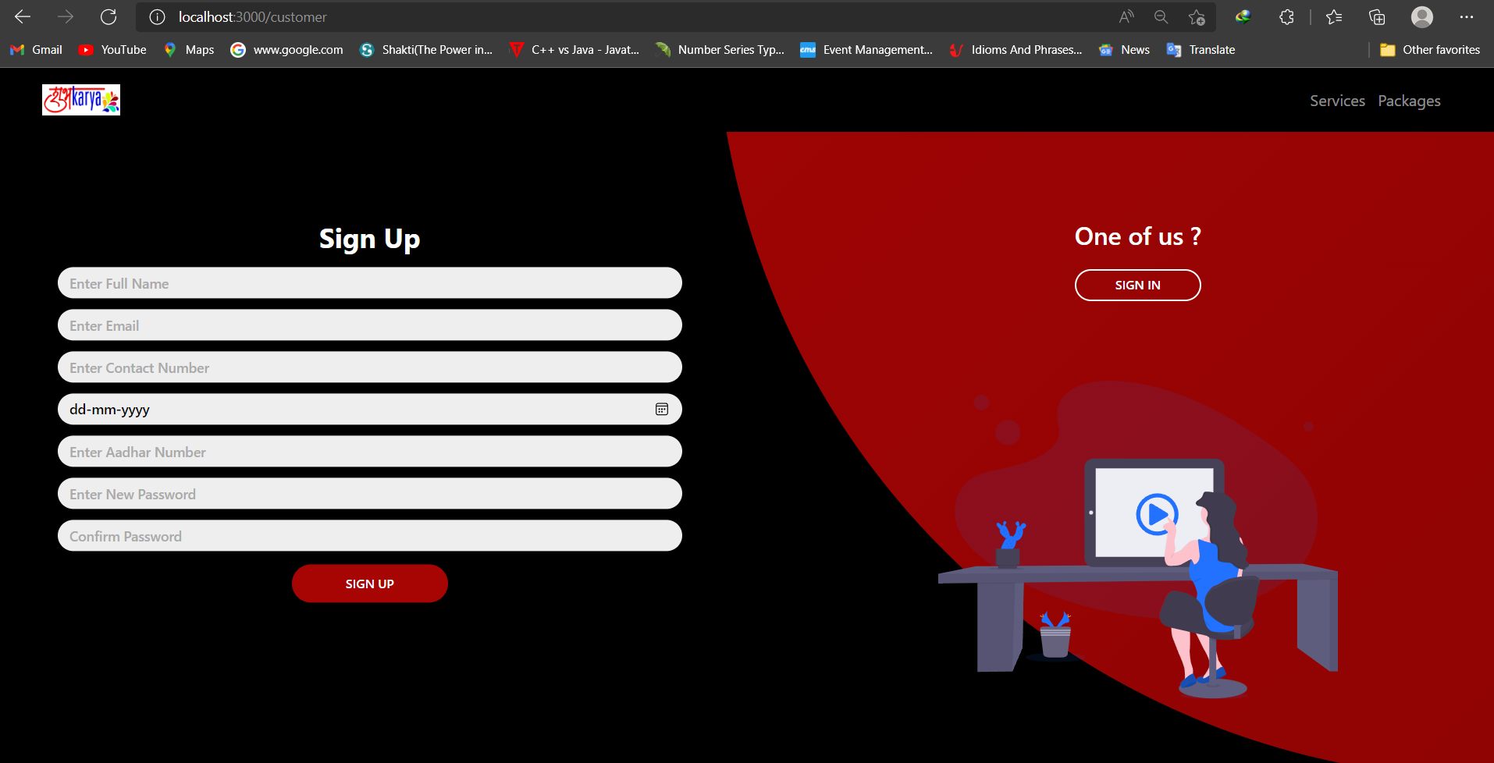

Slide 22
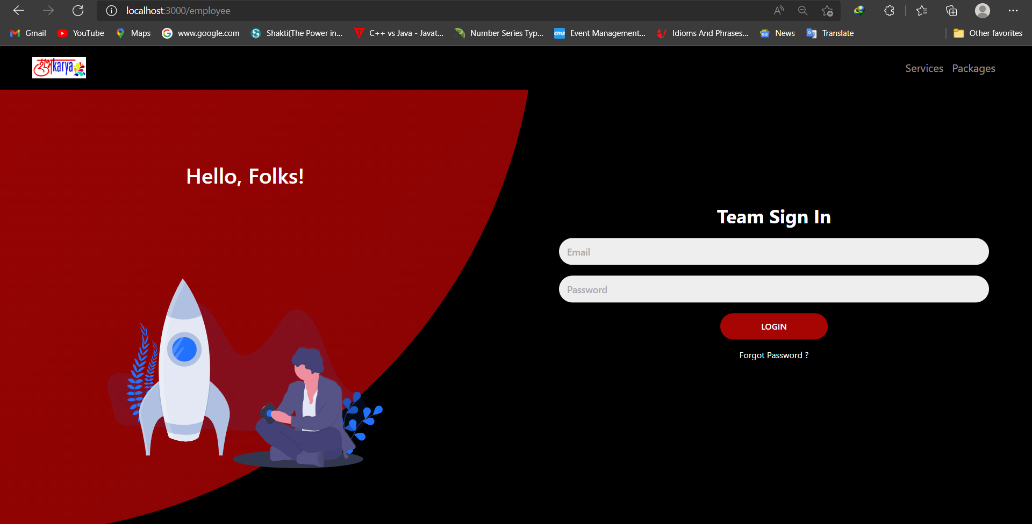

Slide 23
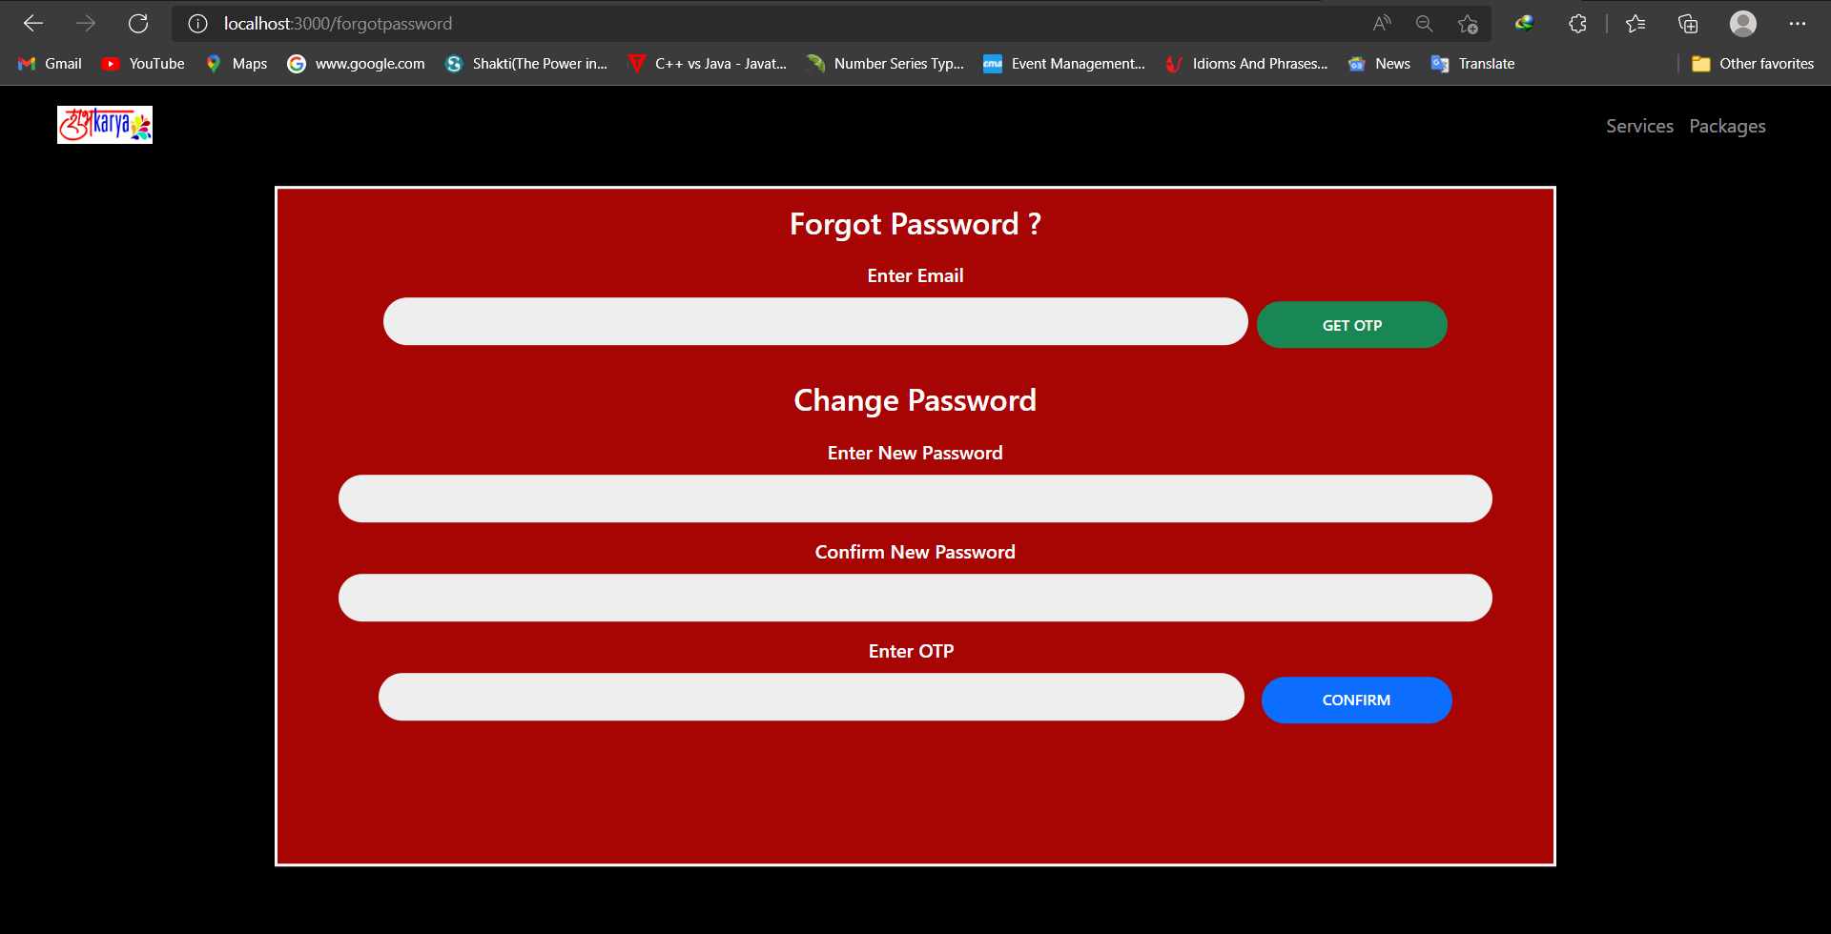

Slide 24
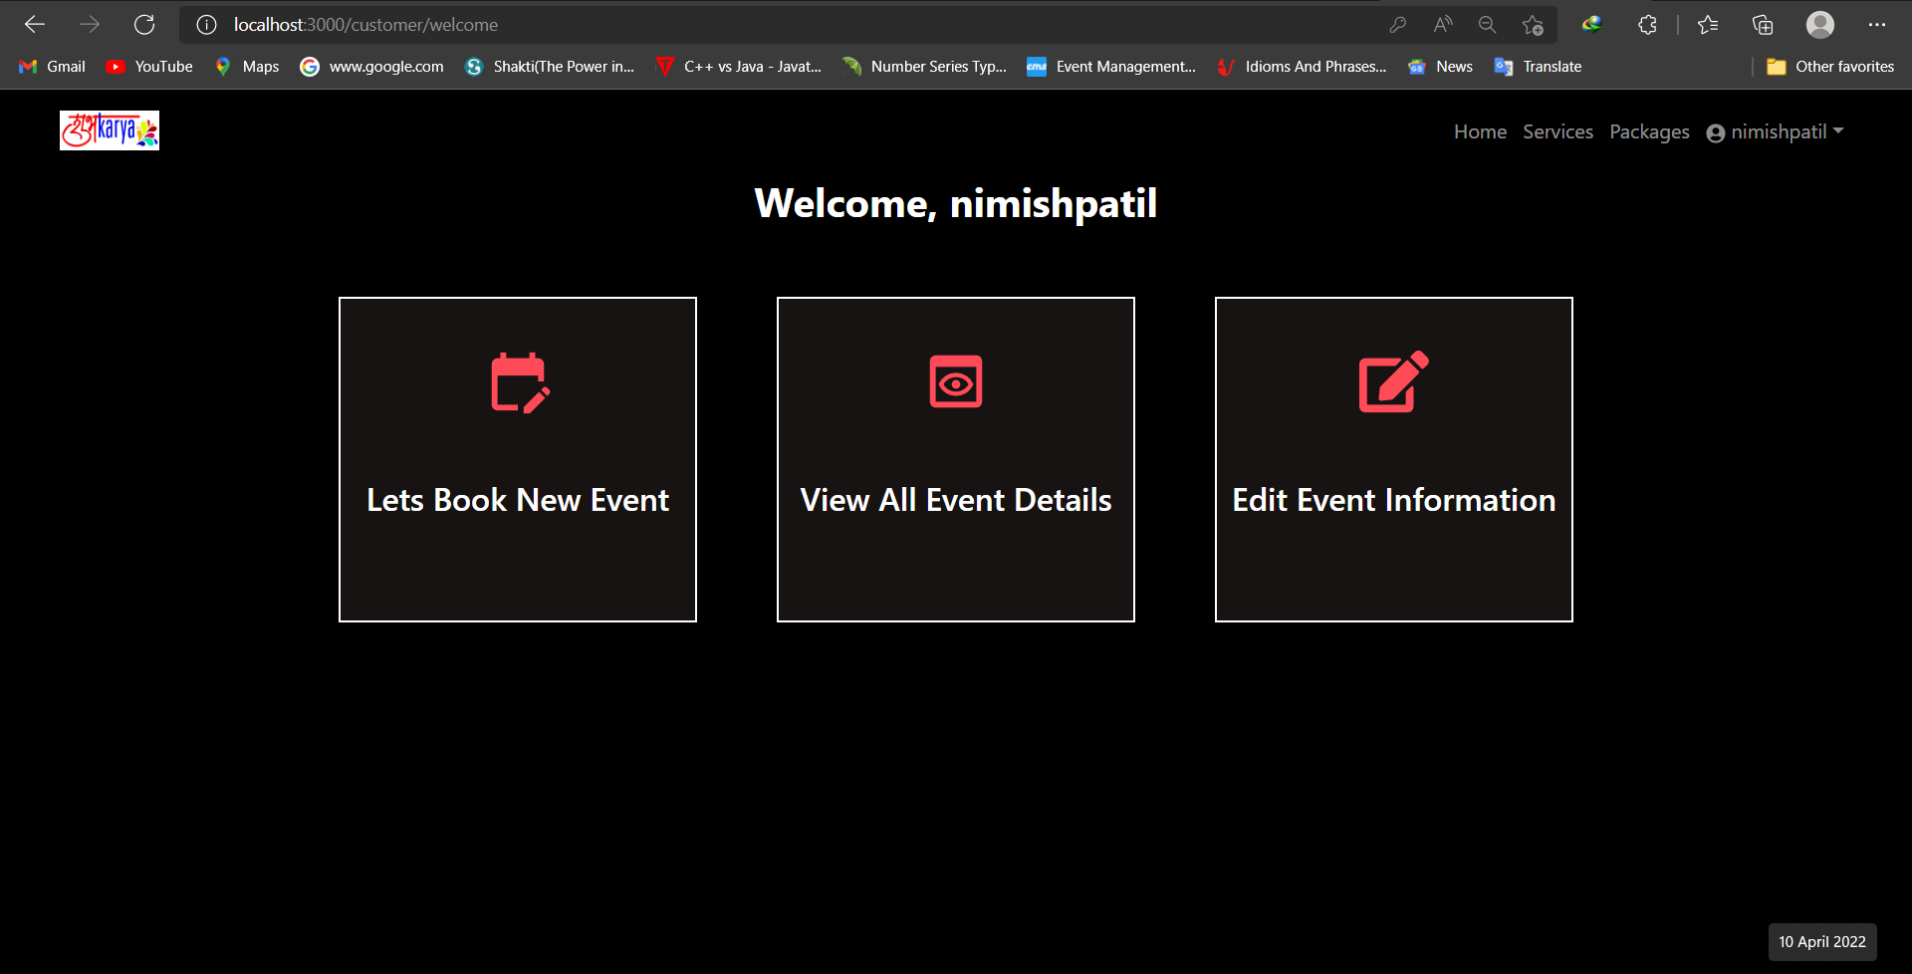

Slide 25
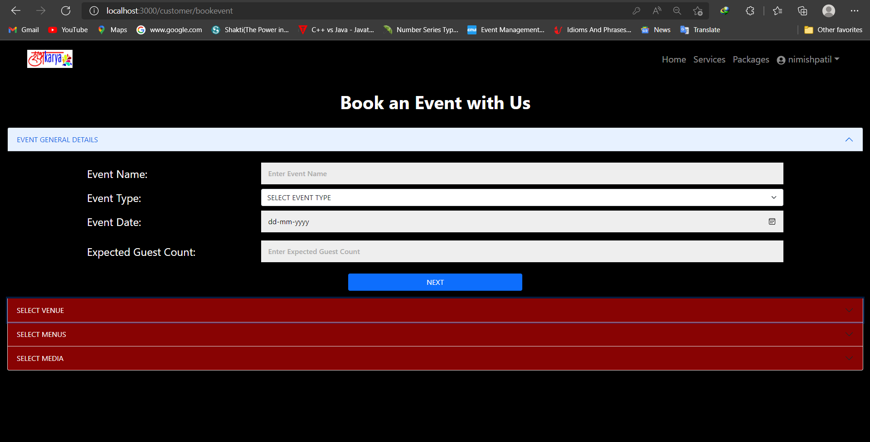

Slide 26
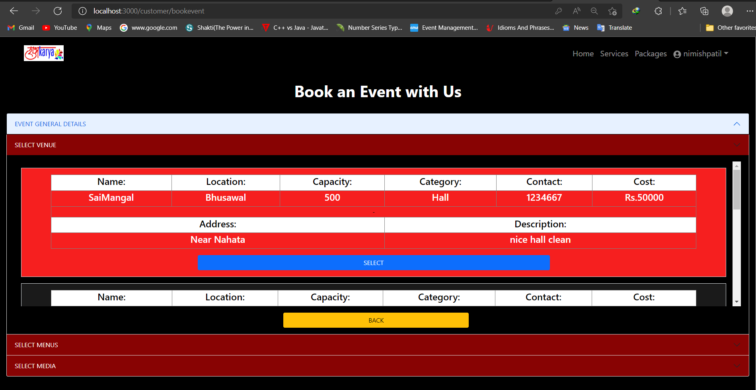

Slide 27
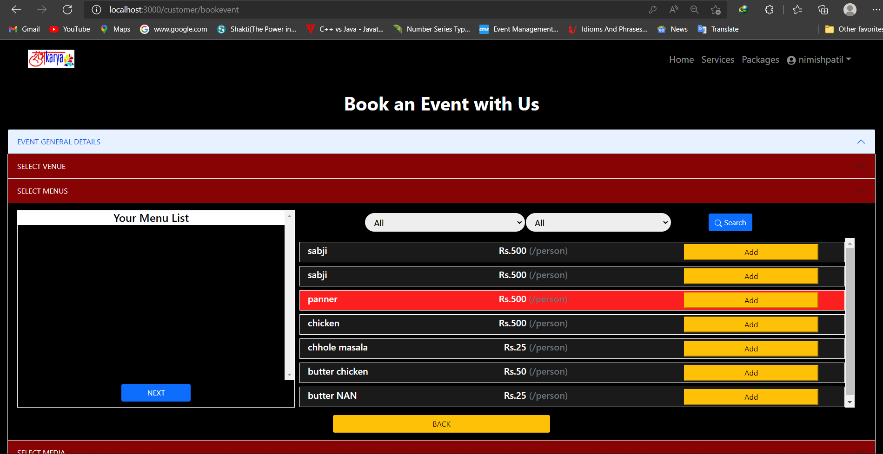

Slide 28
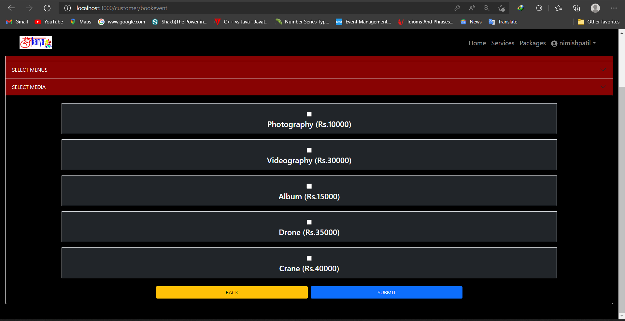

Slide 29
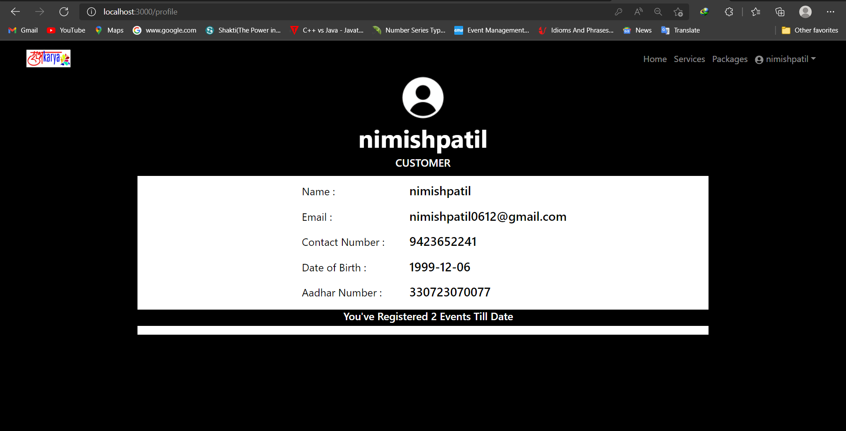

Slide 30
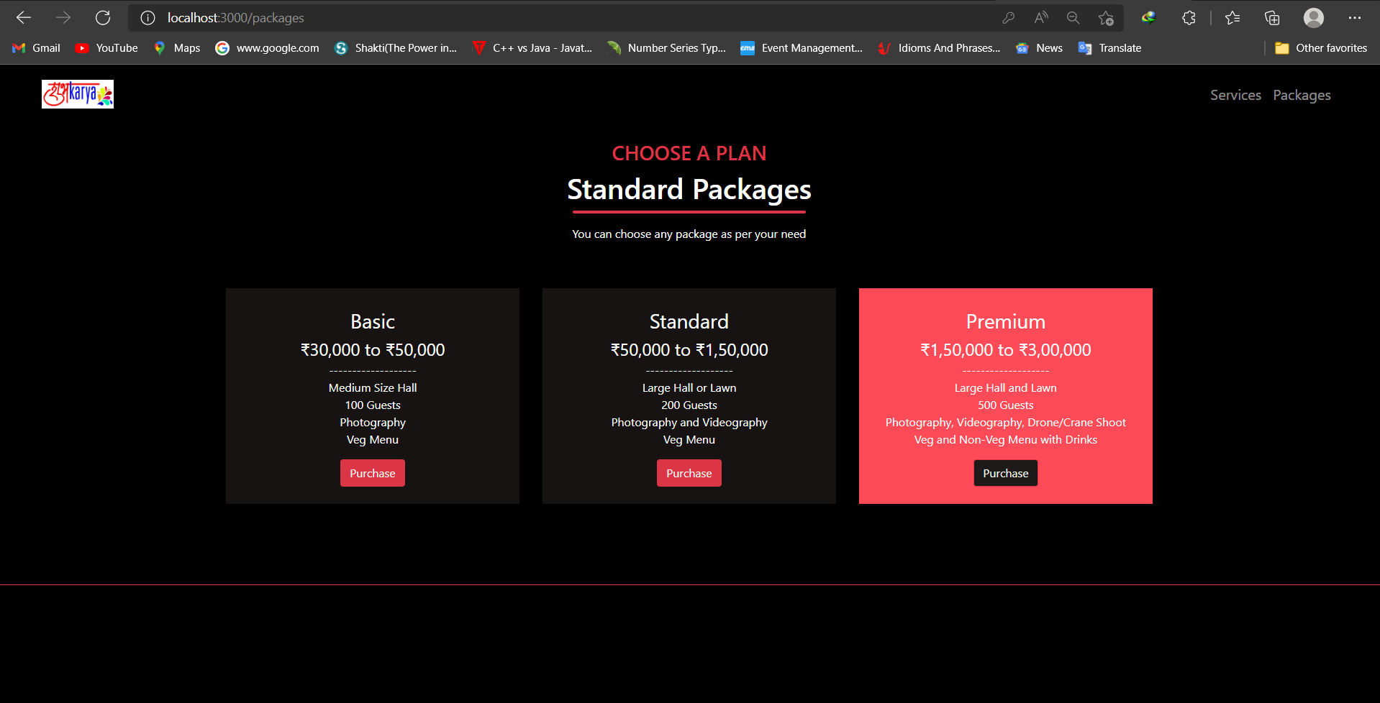

Slide 31
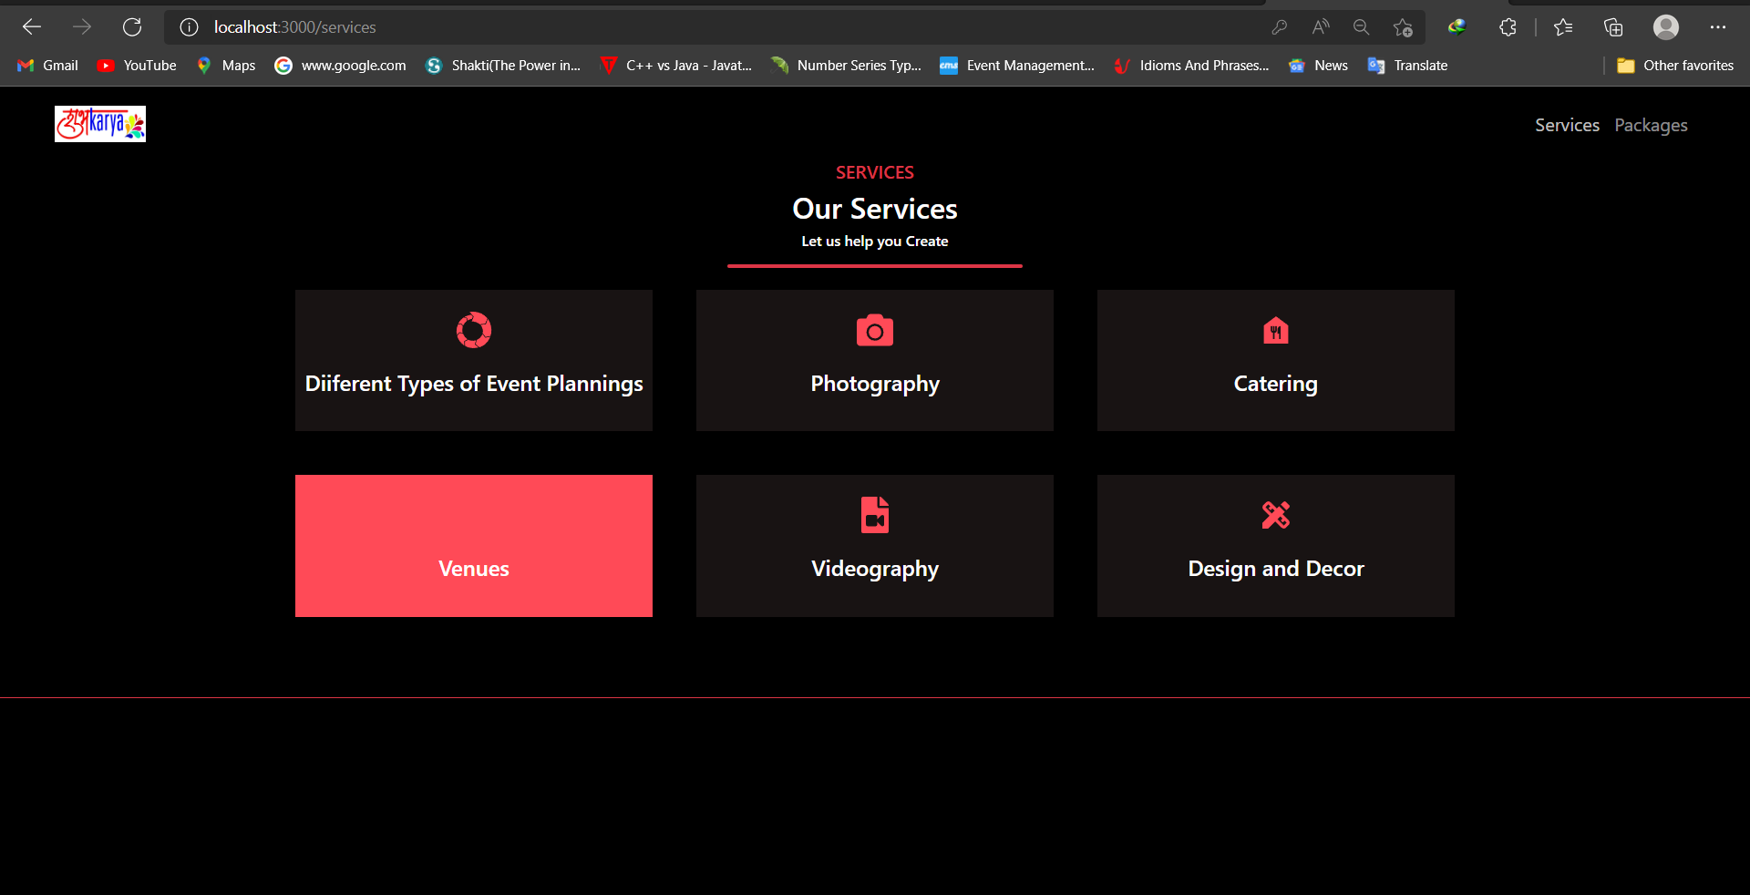

Slide 32
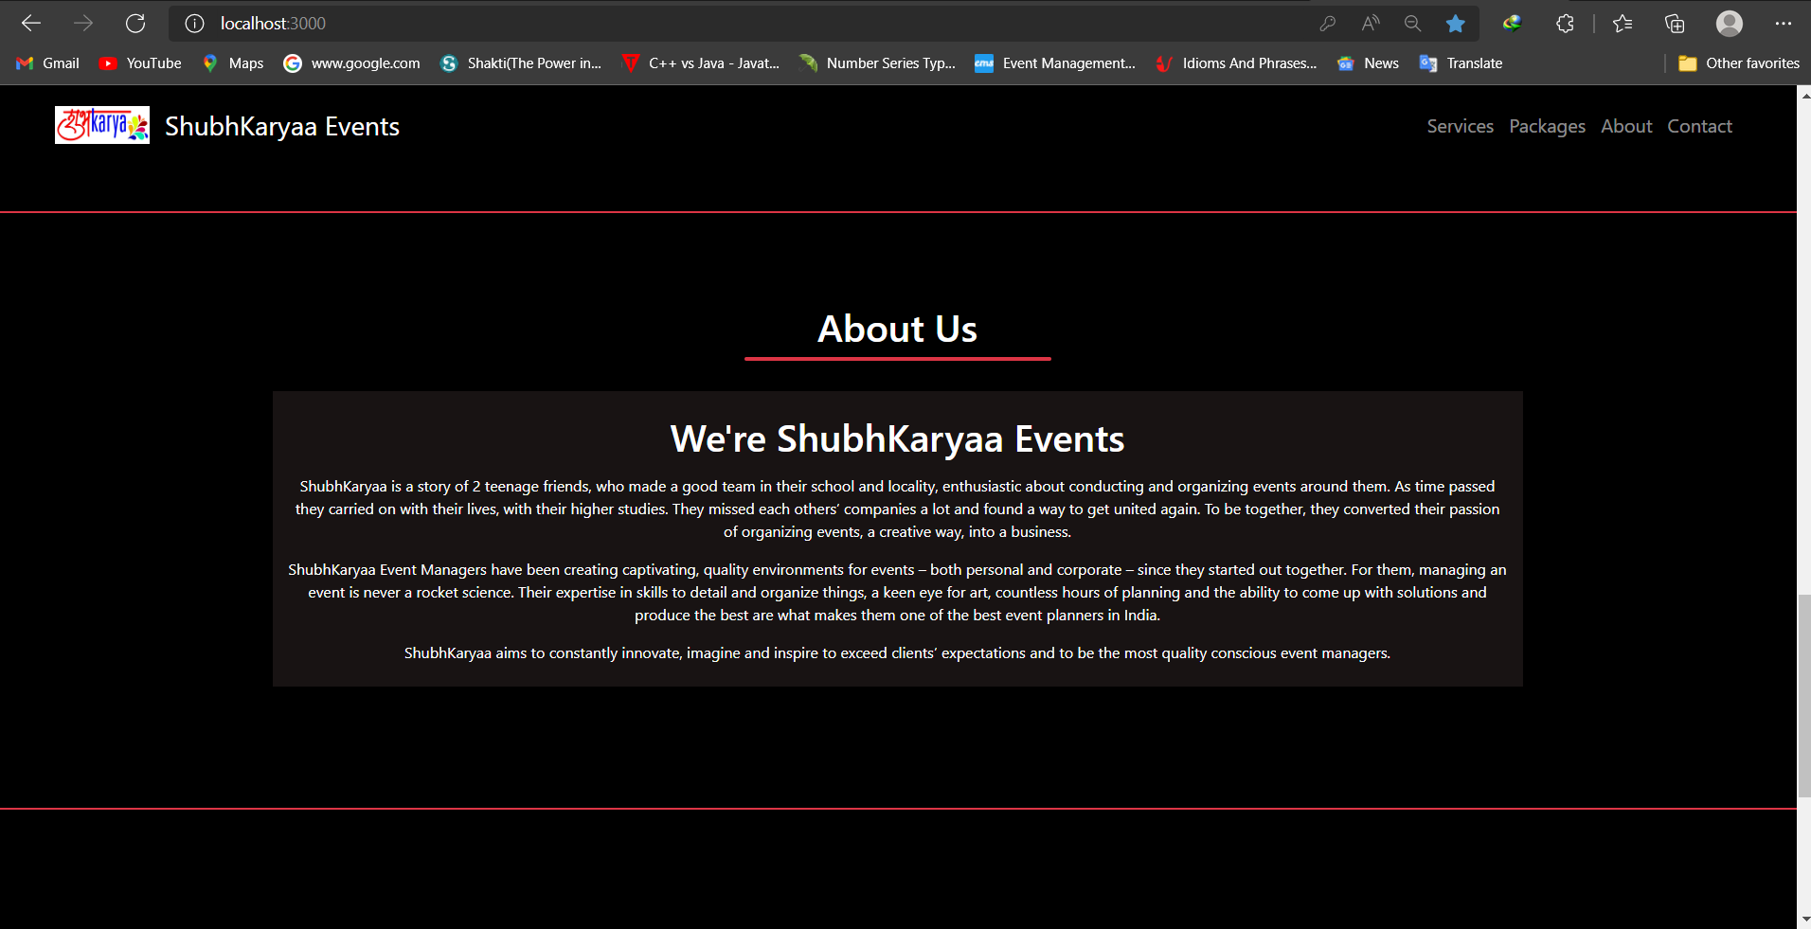

Slide 33
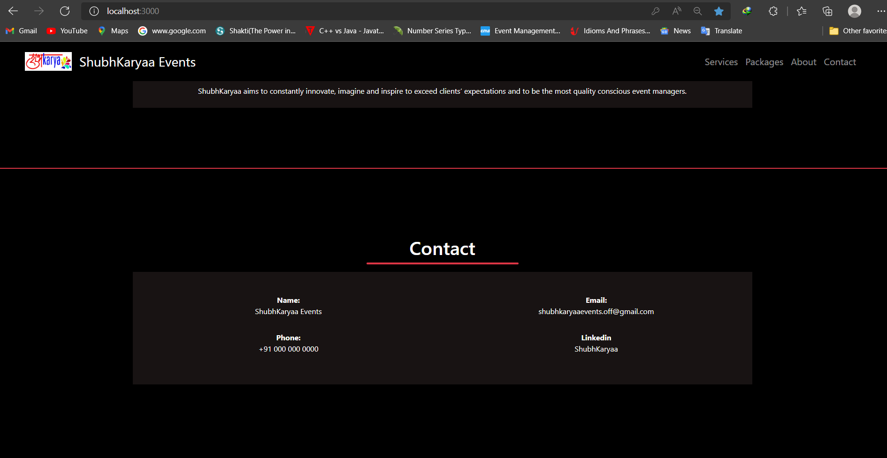

Slide 34
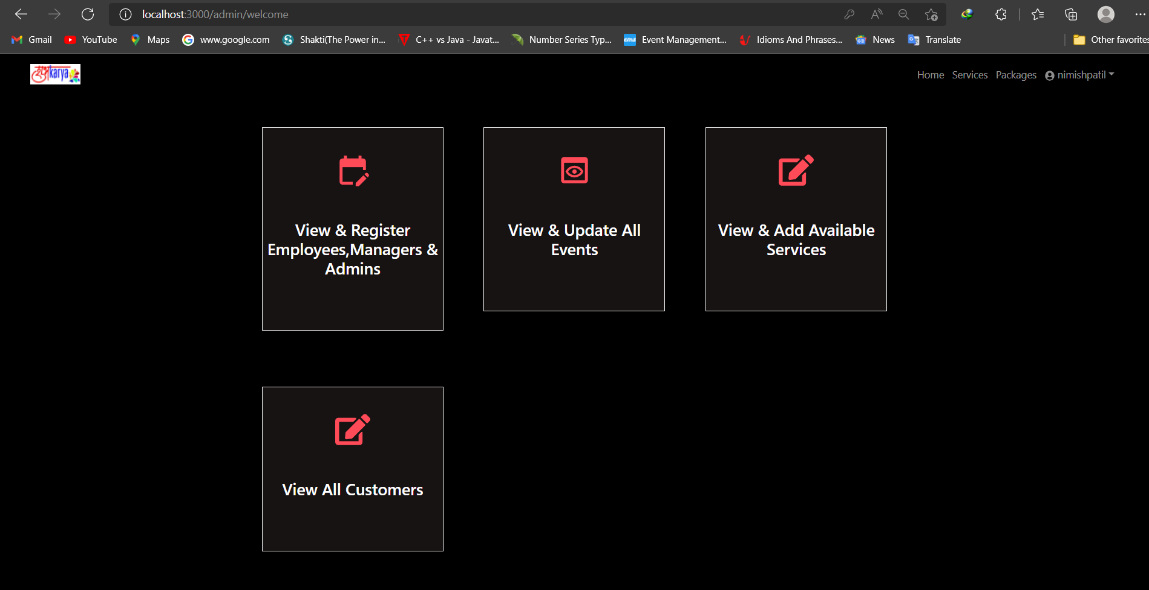

Slide 35
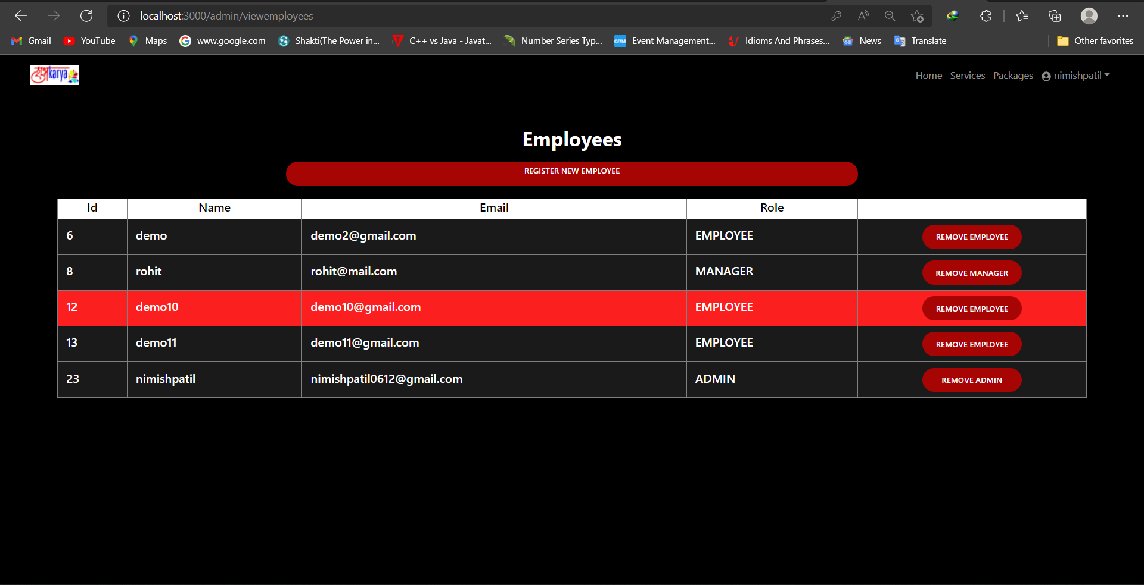

Slide 36
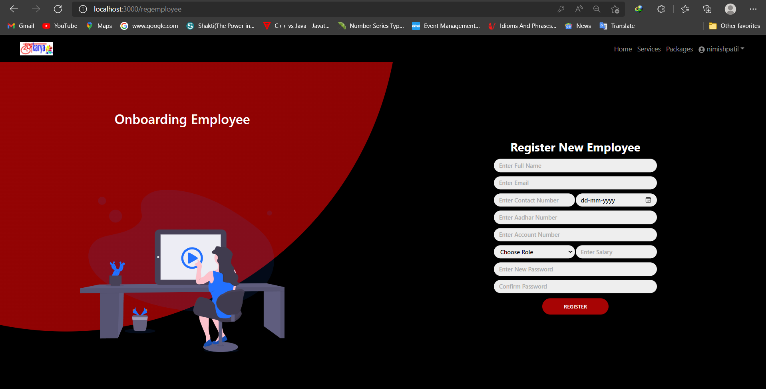

Slide 37
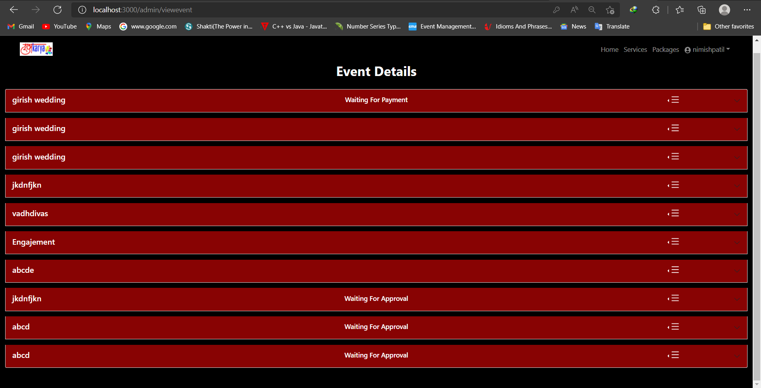

Slide 38
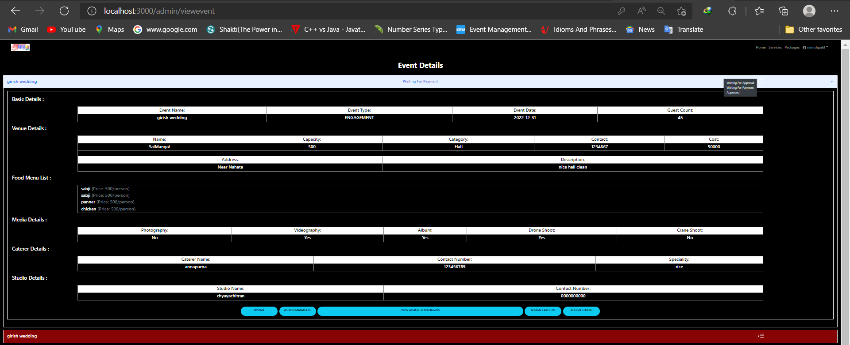

Slide 39
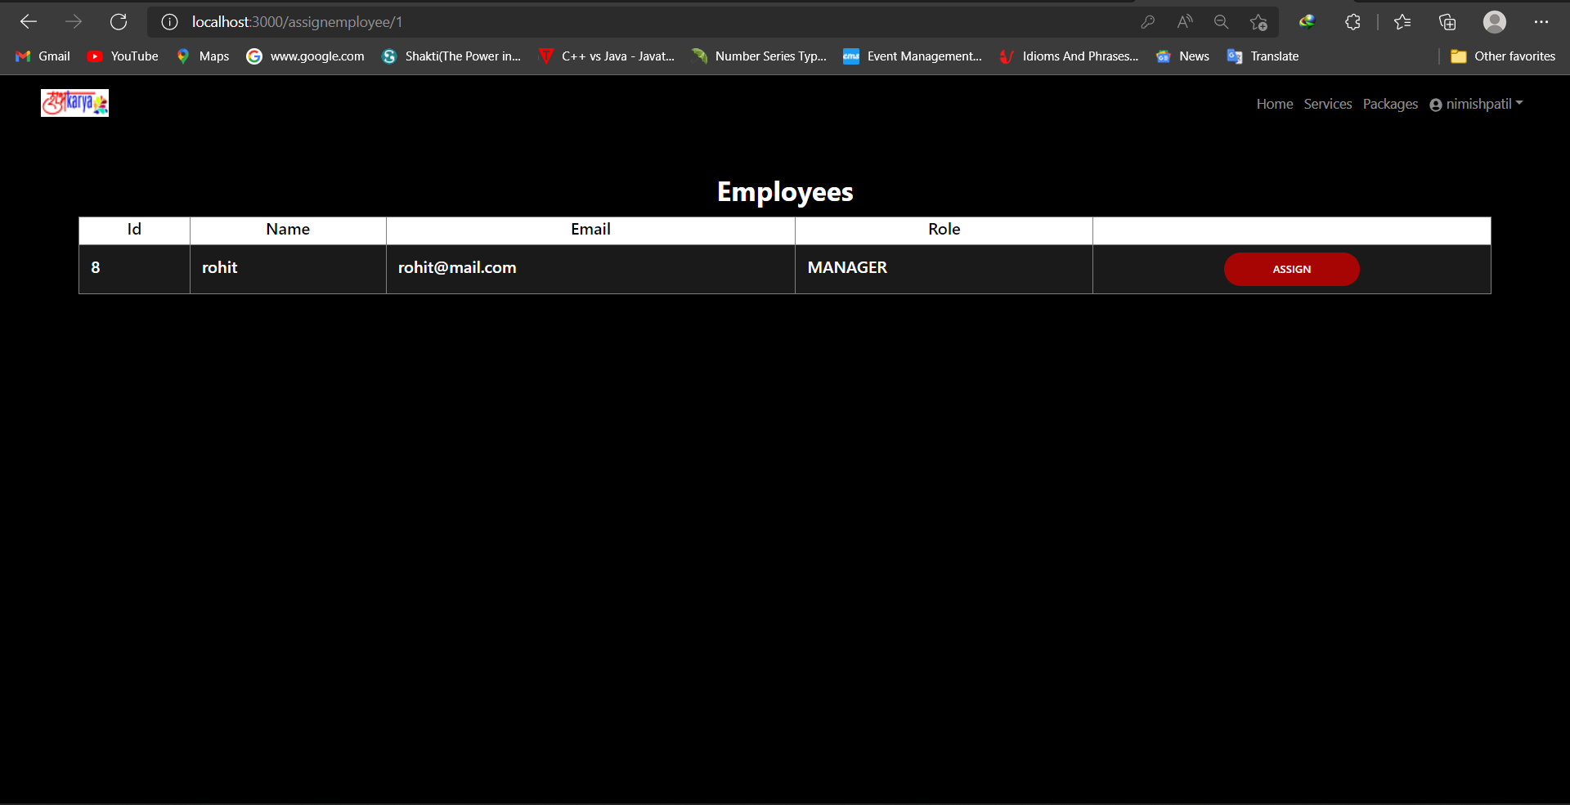

Slide 40
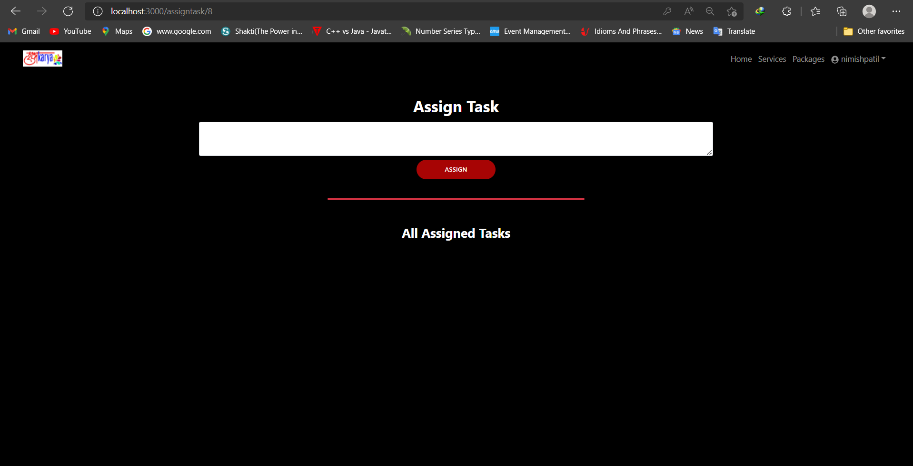

Slide 41
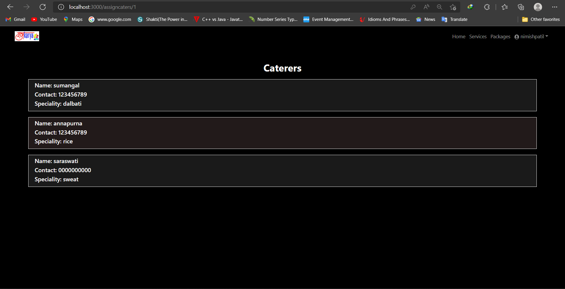

Slide 42
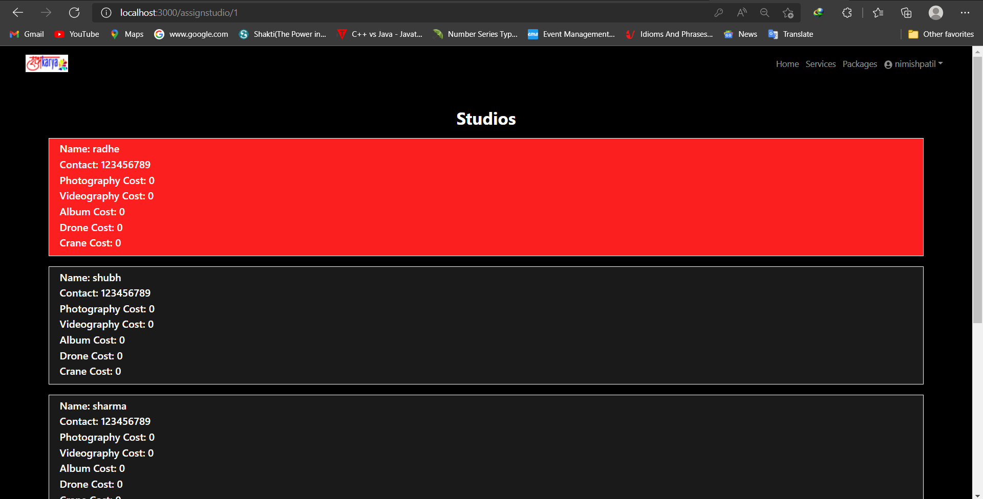

Slide 43
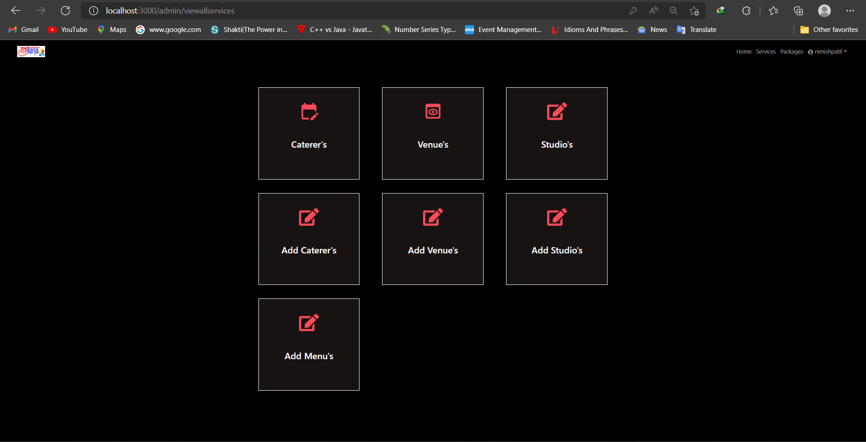

Slide 44
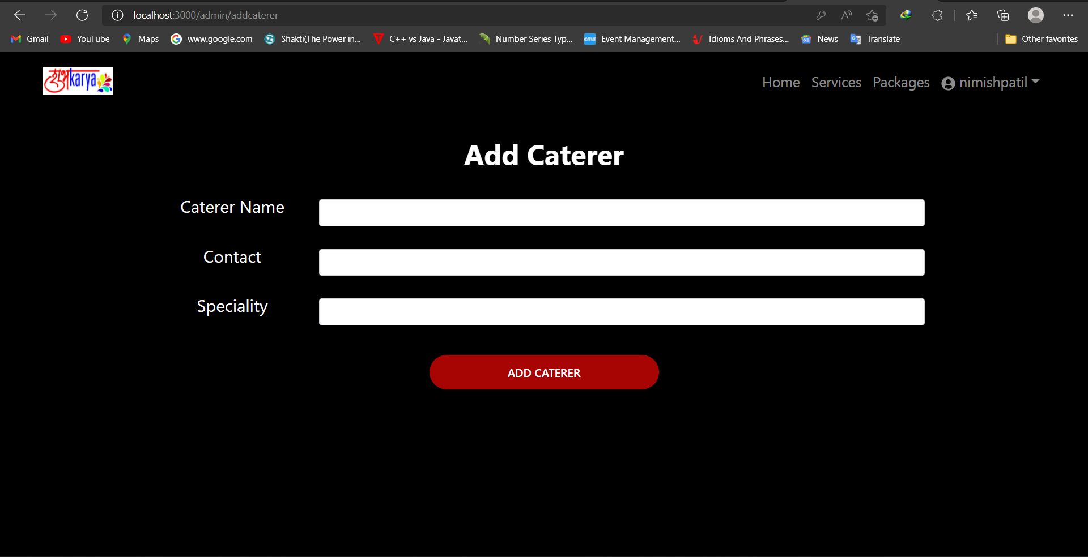

Slide 45
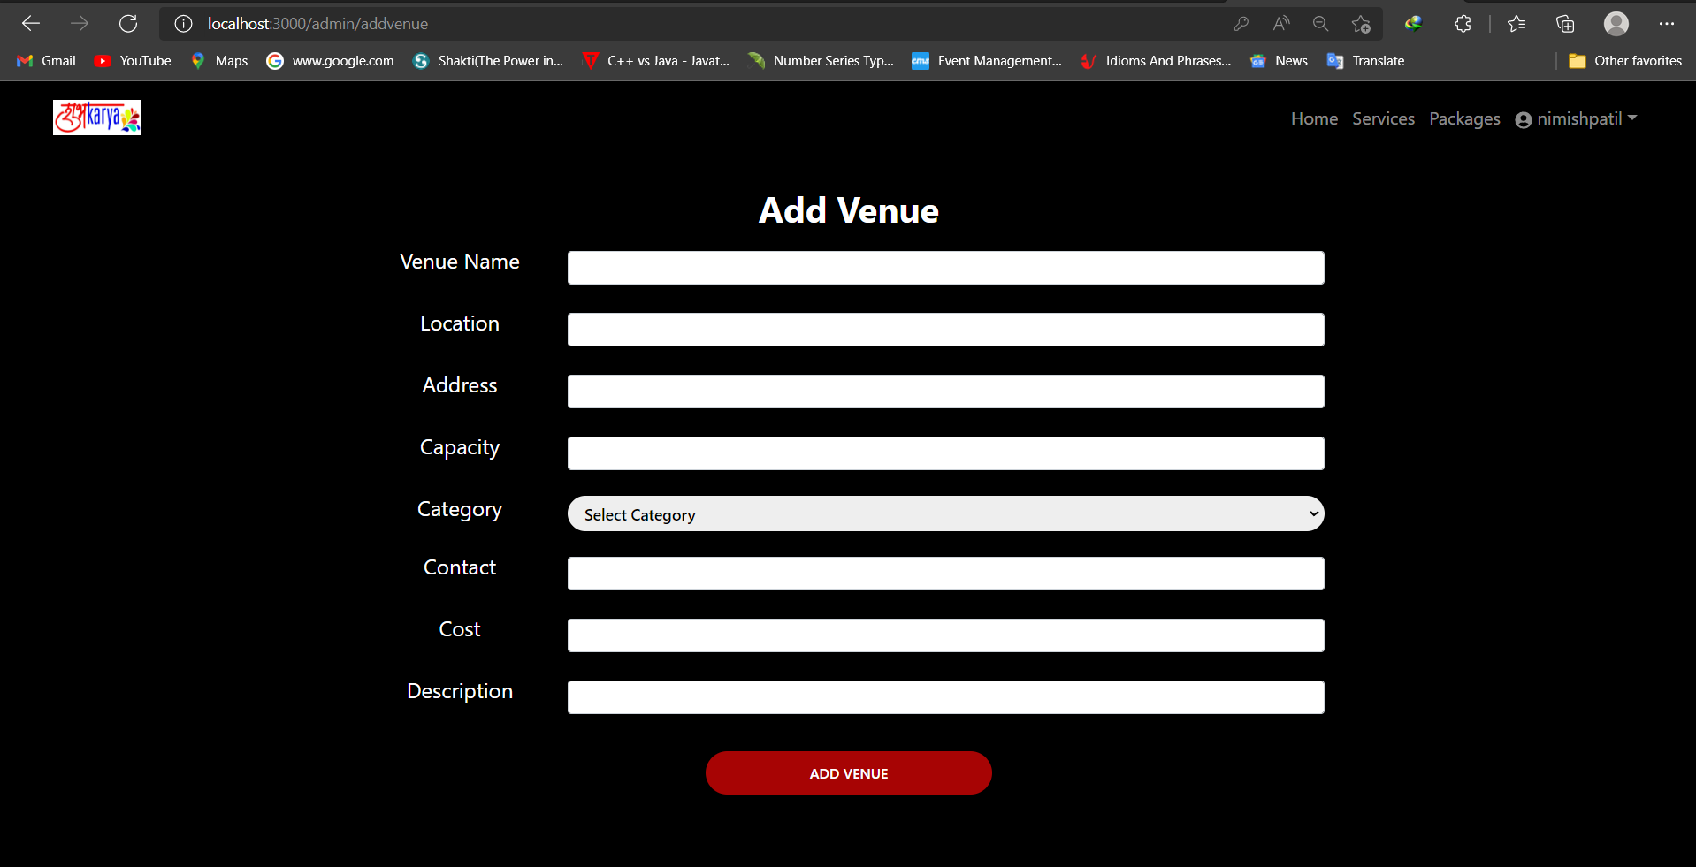

Slide 46
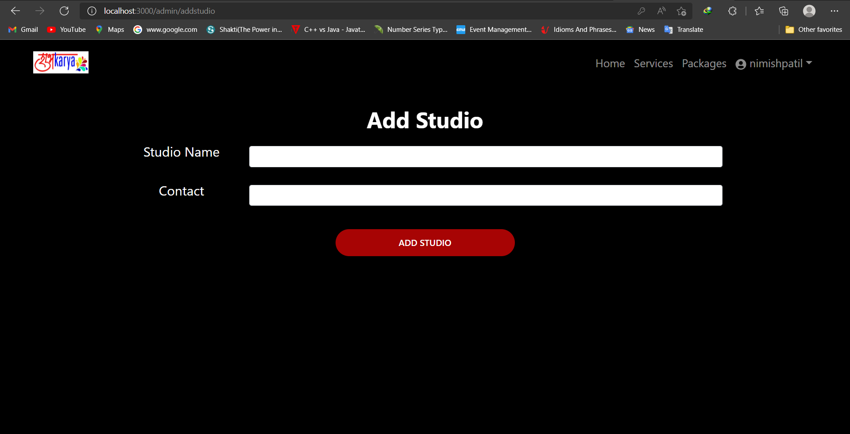

Slide 47
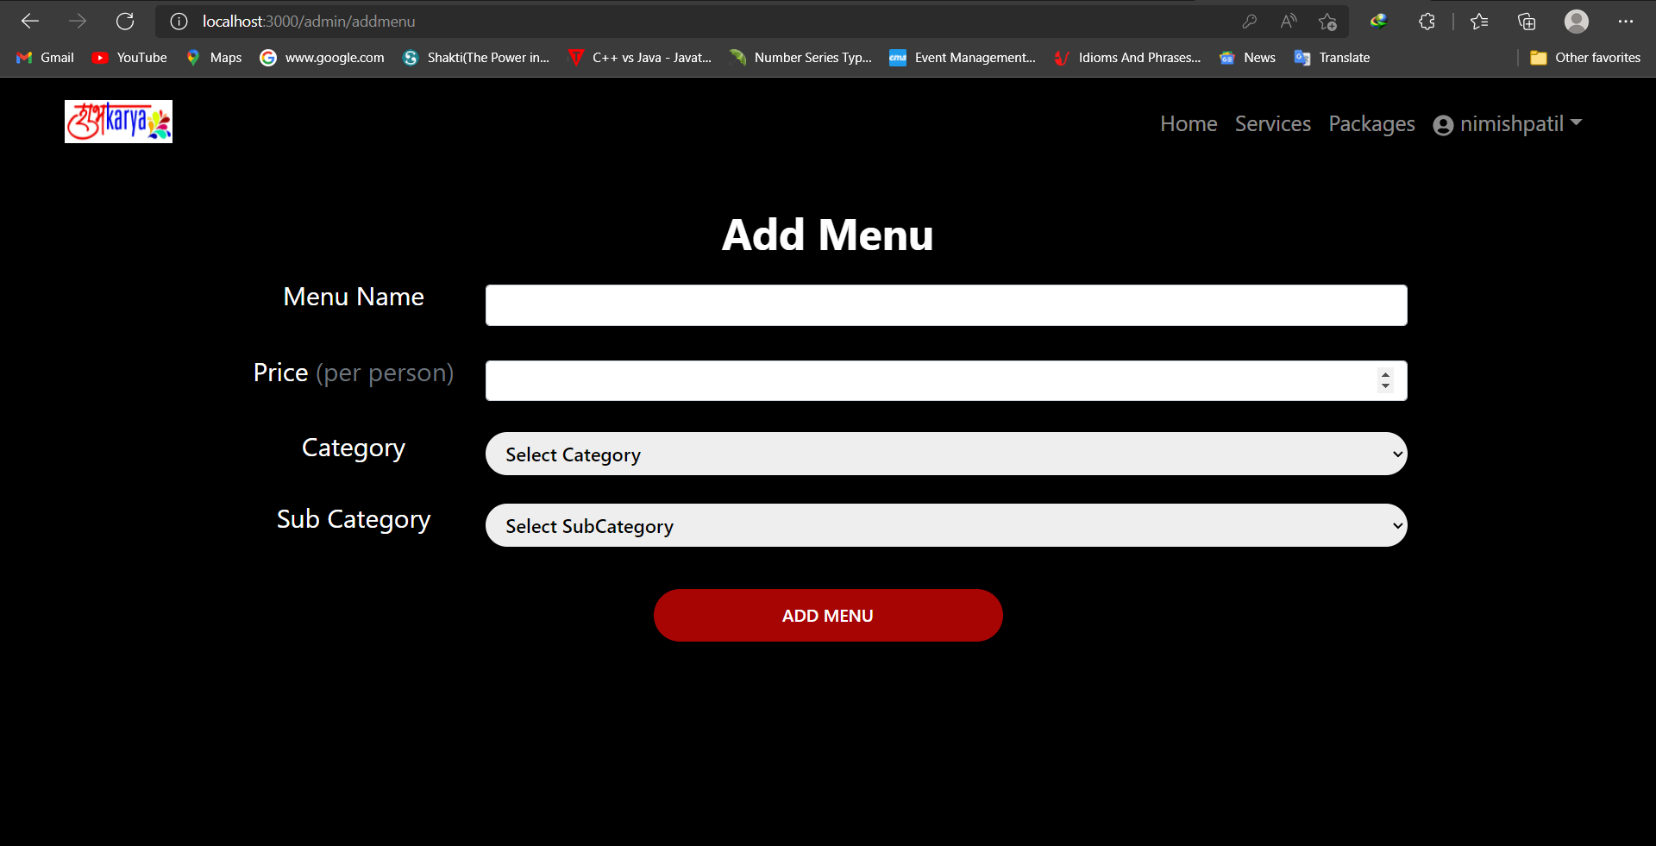

Slide 48
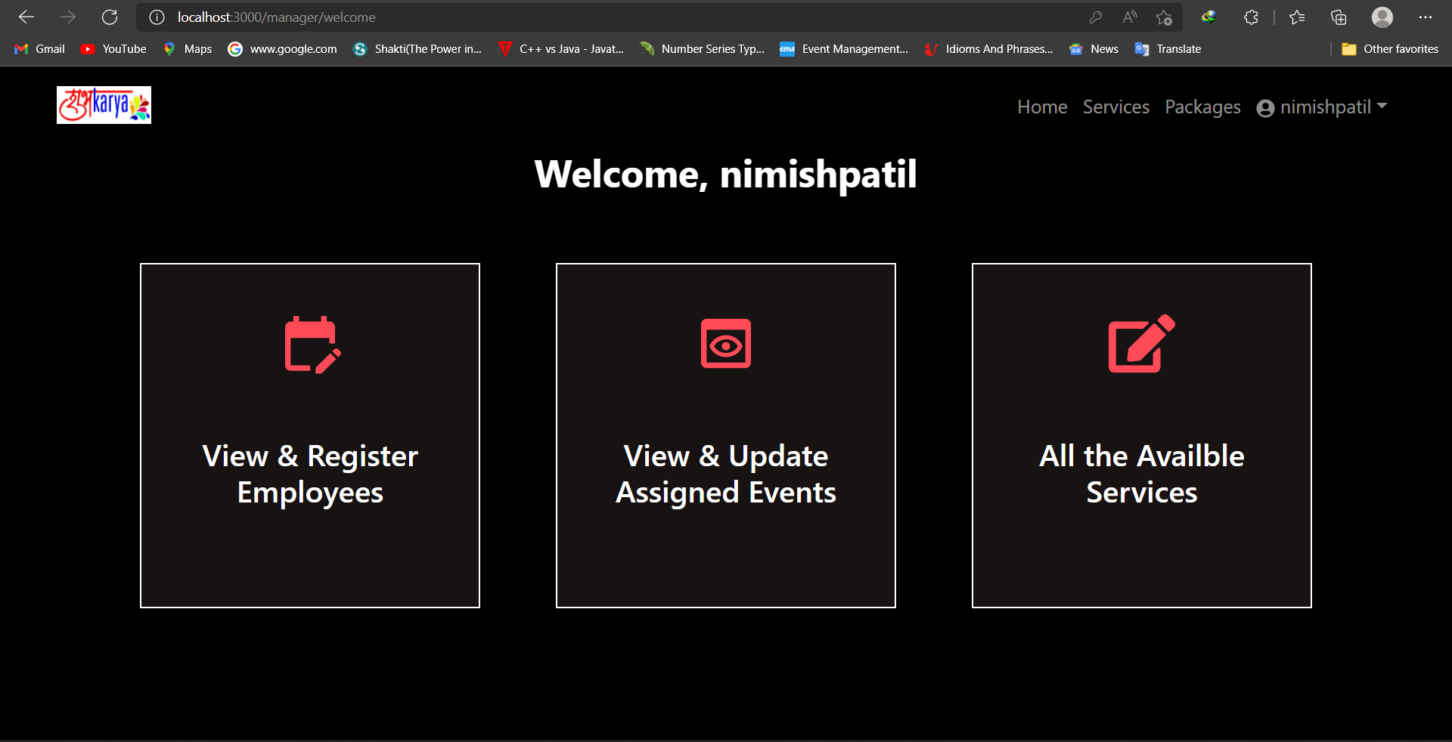

Slide 49
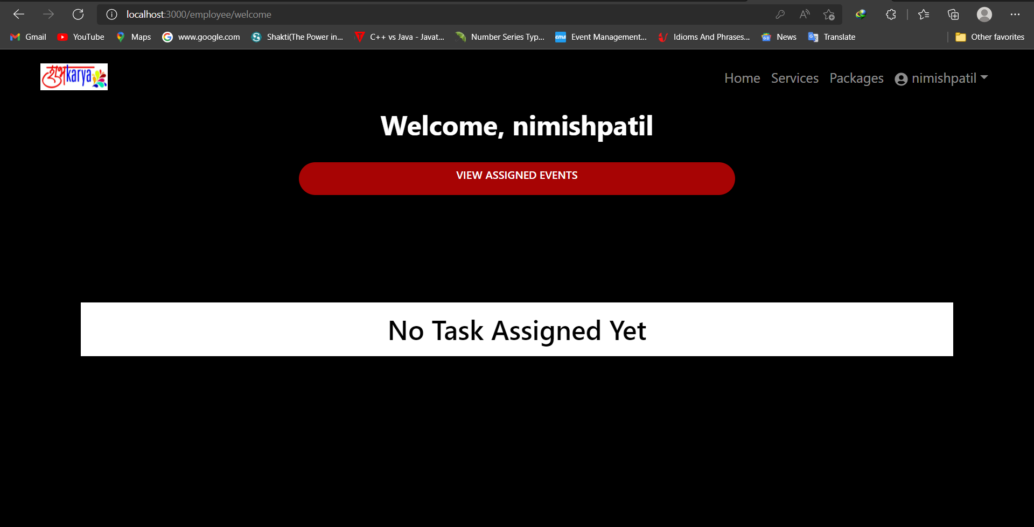

Slide 50
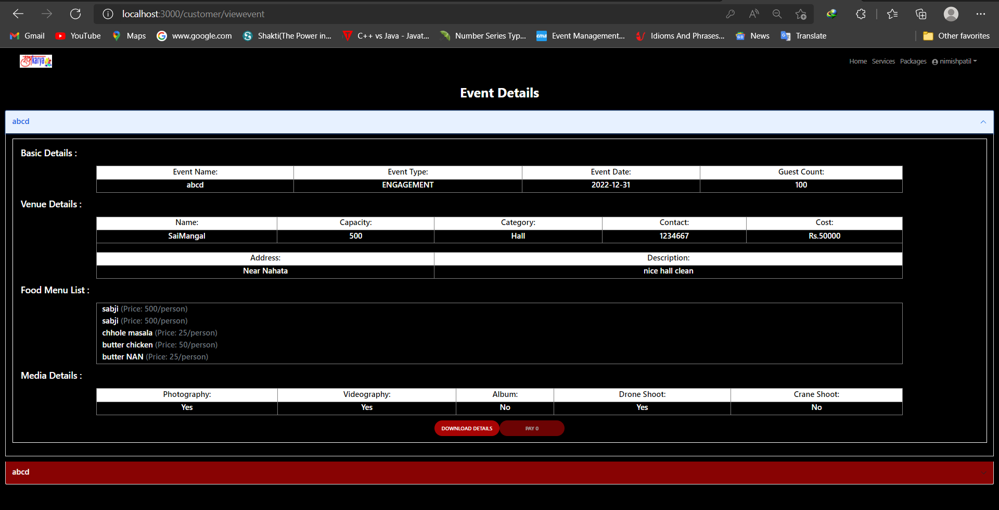

Slide 51
Specification
The application will use JavaScript, jQuery,CSS and Java Spring Boot as main web technologies.
SMTP protocol is used for Email communication.
Several types of validations make this web application a secured one and SQL Injections can also be prevented.
Since Event Management System is a web-based application, internet connection must be established.
The Event Management System will be used on PCs and will function via internet or intranet in any web browser.

Slide 52
S/W and H/W Requirements
Server Side:
Processor: Intel® Xeon® processor 3500 series
HDD: Minimum 500GB Disk Space
RAM: Minimum 4GB
OS: Windows 10, Linux 6
Database: Mysql
Client Side (minimum requirement):
Processor: Intel Dual Core
HDD: Minimum 80GB Disk Space
RAM: Minimum 1GB
OS: Windows 8 and above, Linux

Slide 53
Advantages
This Online Event Management solution is fully functional and flexible.
It is very easy to use.
This Online Event Management System helps in back office administration by streamlining and standardizing the procedures.
It saves a lot of time, money and labour.
Eco-friendly: The monitoring of the Event Management and the overall business becomes easy and includes least paper work.
The application acts as an office that is open 24/7.
It increases the efficiency of management at offering quality services to the customers.

Slide 54
Conclusion
Our project is only a humble venture to satisfy the needs to manage their project work. Several user-friendly coding techniques have also been adopted. This package shall prove to be a powerful package in satisfying the requirements of both the customer and the firm. The objective if software planning is to provide a frame work that enables the manager to make reasonable estimate made within a limited time frame at the beginning of the software project and should be updated regularly.

Slide 55
References
https://www.w3schools.com/ http://www.wikipedia.org
https://getbootstrap.com/
https://docs.spring.io/spring-data/jpa/docs/current/reference/html/#jpa.query-methods.query-creation

